Slide 1
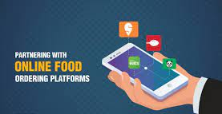
SOFTWARE ARCHITECTURE ASSIGNMENT - II
Food ordering platform (Zomato/Swiggy)
Submitted By:- Deepak Jain
Student ID : 2021MT12286 2021MT12286@wilp.bits-pilani.ac.in

Slide 2
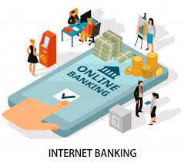
Description Of Application
With advent of technology all items viz electronics, apparels, clothing, medical care, grocery, food items everything online can be ordered.
Food industry is also accepting the orders online and undertaking delivery within time post order acceptance.
To design a food industry delivery portal and app with certain consideration

Slide 3
TASK -1
Identify top 3 Architecturally Significant Requirements (ASRs) and write them in the form of a Utility tree. Why are these architecturally significant?
Availability - The system should be available to customers at all times so that orders can be accepted and served at any hour of the clock, It should run with minimum downtime.
Security - Since applications have to deal with online transactions, a reliable third party vendor which can manage payments and must accept a wide range of payment methods.
Usability - App should be horizontally scalable as per business demand and easy as per users requirement.

Slide 4
TASK -1
Identify top 3 Architecturally Significant Requirements (ASRs) and write them in the form of a Utility tree. Why are these architecturally significant?
Quality Attribute | Attribute Refinement | ASR
Availability | No downtime Monitoring & Protection | The system should be up 24x7. Illegitimate network connections and use of local resources are not allowed.
Security | Confidential & Integrity | User data must be protected against access by hackers. User’s data stored should confidential. Critical system resources are protected against malicious tampering.
Usability | Facility of use | The system should be intuitive and easy to learn, users should be able to use the system without the need of training.

Slide 5
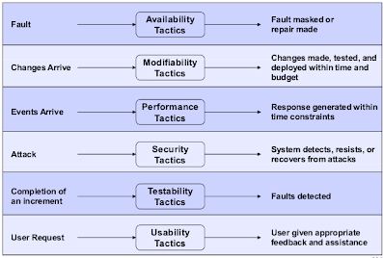
TASK -2
Describe in detail, the tactics you recommend for each ASR. For example, if caching is a tactic you recommend, please mention what you will cache, what tool you would use, how it will work, etc.

Slide 6

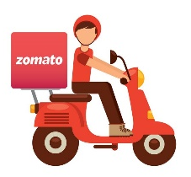
TASK -3
Draw 2 software architecture diagrams – component & connection view and deployment view – to understand how the system works.
Restaurant
Places Order
Sends Order
Customers preferences
Confirmation of delivery
Food Ordering system
(Software system)
Accepts the Order
Allocated delivery Agent
Accepts Order
Update menu and gives confirmation
Customer notification of delivery
Payment request
Customer details and restaurant details
Payment confirmation
Payment system
UPI/cards/cash/Internet banking
Component View
Delivery Agent

Slide 7

TASK -3
Draw 2 software architecture diagrams – component & connection view and deployment view – to understand how the system works.
Container
Customer data with authentication
Container
Restaurant details
Orders handler (in Java)
UI
(Frontend application)
Order Details
Send for Payment
API Gateway
Container
Delivery agent details and authentication
Menu Details
Each Restaurant details with menu
Payments handler
(in Java)
Mobile App
Order Details
Confirmation
Payment process
Notification System
E-Mail/ SMS
Order status
Payments gateway
(UPI etc)
Deployment View
Delivery Agent

Slide 8
TASK -4
Indicate important messages between components by labelling the connections in the C&C view. Also indicate the communication method used.
Elements Components are principal units of runtime interaction and data stores Connectors are interaction mechanisms Relations Attachment of components’ ports to connectors’ roles (interfaces with protocols) Properties Name Runtime quality-of-service information to facilitate analysis or prediction of runtime quality attributes. Use: Construction - for specifying the behavior that elements must exhibit Analysis - for reasoning about runtime system quality attributes such as Availability, Security & Usability Education - as a starting point for the architect to show how the system works Notations Informal box-and-line diagrams Most box-and-line diagrams showing runtime behavior are in fact attempting to be C&C views. Formal - Architecture description languages such as Acme, Wright, UniCon, the Architecture Analysis and Design Language (AADL), and Rapide Semi-formal - UML not always a straightforward mapping major improvements in UML 2.0

Slide 9

TASK -5
Draw a sequence diagram for one major scenario (use case). Mention the scenario.
Data Source (Customer)
Filter Mobile /Web app
Filter Authentication Service
Filter user Past Order History
It will access recommendation and DB when it is not the first Order
FILTER
Adding data in a DB according to user preferences based on past history
FILTER
Remove redundant data
(example – time of Order)
DATABASE
(MariaDB)
To store recommendation
Order by a user to a restaurant of old preferences

Slide 10
TASK -6
State the architecture patterns used. Explain, wherein the architecture, these patterns have been used.
Presentation Layer
Mobile/Web Application
Allows customers to select and place the order and send info to the business layer
Business Layer
Authentication Service, Order handler, Payment handler
Authorize customers and process payment with allocated delivery agent
Data layer
Database
Stores all the orders information such as customers data, delivery agents details, restaurant details, Menu of each restaurant

Slide 11
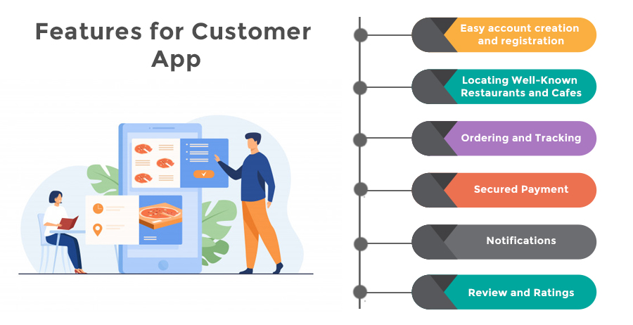
TASK -6
State the architecture patterns used. Explain, wherein the architecture, these patterns have been used.

Slide 12
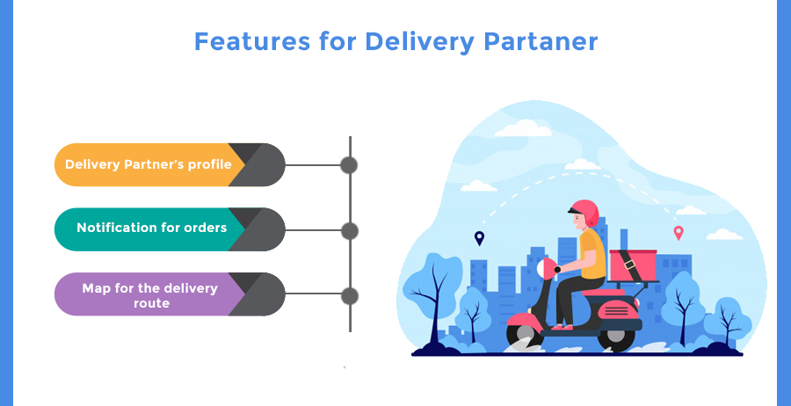
TASK -6
State the architecture patterns used. Explain, wherein the architecture, these patterns have been used.

Slide 13
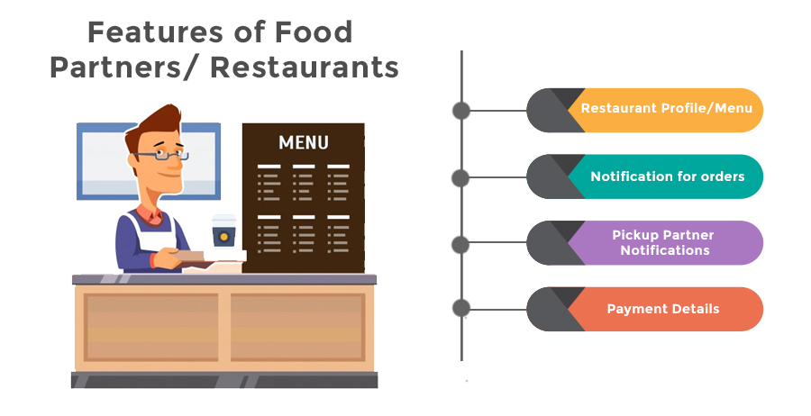
TASK -6
State the architecture patterns used. Explain, wherein the architecture, these patterns have been used.

Slide 14
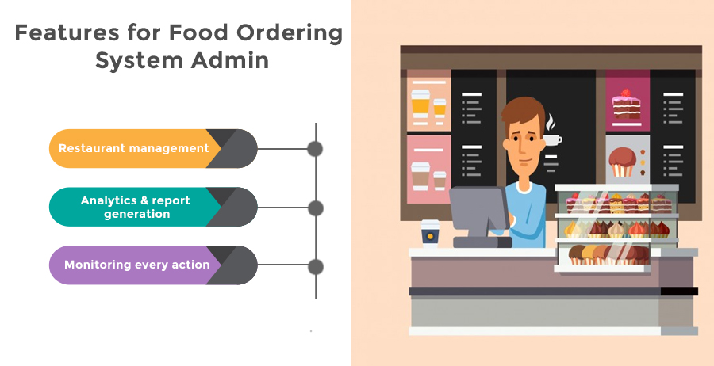
TASK -6
State the architecture patterns used. Explain, wherein the architecture, these patterns have been used.

Slide 15
TASK -7
What did you learn by doing this assignment? Mention 3 key learnings.
Creates a solid foundation for the software project and makes your platform scalable. It increases the performance of the platform, reduces costs, and avoids code duplicity.
It helps you in implementing a vision, helps an organization analyze leading to to cost savings.
Allows for better code maintainability.
Increases the quality of the platform, helps manage complexity and makes the platform faster.
New technical features approach in case of amendments.
Easier to maintain existing software as the structure of the code is visible and known. It makes us for easier debugging and anomalies.
Helps in risk management, reduces its time to market and reduces development time, Which is extremely important and play vital role in the Software Development Life Cycle.

Slide 16
THANK YOU

